Slide 1
Institute for Quantitative & Computational Biosciences Workshop4: NGS- study design and short read mapping
Luz Orozco
Collaboratory website
http://qcb.ucla.edu/collaboratory/
Slides for Workshop4
http://qcb.ucla.edu/collaboratory/workshops/collaboratory-workshop-4/
Notes:
Insert new python script demultiplex script
How to log in to hoffman tomorrow?
How to scp to hoffman tomorrow?

Slide 2
Day1
NGS study design:
Types of studies
Types of library preparations
Types of sequencing runs - paired versus single end, read lengths and qualities
Biological replicates
Costs, coverage and multiplexing
Potential biases and batch effects
Computation requirements
NGS analysis – introduction and read QC:
Public resources
Crash Unix course (refresher)
Download your data (refresher)
Read file formats – what do all these columns mean?
Log-in to Hoffman2 cluster
Conversion of “.qseq” read files to “fastq”
Demultiplexing
Read QC
Notes:
Today we are going to discuss study design in depth and start sequence analysis.
The first lecture will focus on the different considerations that affect study design. This is the most important part of your plan, and usually mistakes here are very difficult or impossible to fix in the after math.

Slide 3
Choose the right application for your question
Genetic
variation
Quantification
(expression,
protein-DNA binding,
regulation of expression)
DNAseq
Exome
RNAseq, miRNA
ChIPseq
BSseq (methylation)

Slide 4
Choose the right application for your question
Genetic
variation
Quantification
(expression,
protein-DNA binding,
regulation of expression)
DNAseq
Exome
RNAseq, miRNA
ChIPseq
BSseq (methylation)

Slide 5
Choose the right application for your question
Genetic
variation
Quantification
(expression,
protein-DNA binding,
regulation of expression)
DNAseq
Exome
RNAseq, miRNA
ChIPseq
BSseq (methylation)

Slide 6
Choose the right application for your question
Genetic
variation
Quantification
(expression,
protein-DNA binding,
regulation of expression)
DNAseq
Exome
RNAseq, miRNA
ChIPseq
BSseq (methylation)

Slide 7
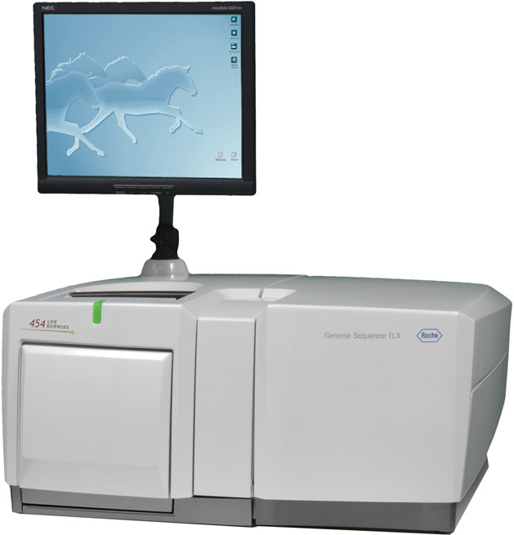
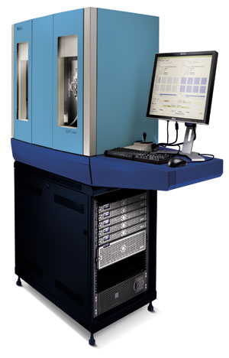
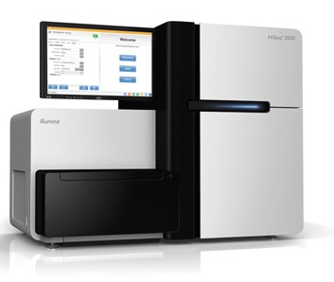
Choose the right platform for your study
Roche 454
Cost
Information content
Availability
ABI
Illumina

Slide 8
Method | Read length | Accuracy | Reads per run | Time per run | Cost per 1 million bases (in US$) | Advantages | Disadvantages
Single-molecule real-time sequencing (Pacific Bio) | 5,500 bp to 8,500 bp avg (10,000 bp N50); maximum read length >30,000 bases | 99.999% consensus accuracy; 87% single-read accuracy | 50,000 per SMRT cell, or ~400 megabases | 30 minutes to 2 hours | $0.33–$1.00 | Longest read length. Fast. Detects 4mC, 5mC, 6mA | Moderate throughput. Equipment can be very expensive.
Ion semiconductor (Ion Torrent sequencing) | up to 400 bp | 98% | up to 80 million | 2h 0m 0s | $1 | Less expensive equipment. Fast. | Homopolymer errors.
Pyrosequencing (454 Roche) | 700 bp | 99.90% | 1 million | 24h 0m 0s | $10 | Long read size. Fast. | Runs are expensive. Homopolymer errors.
Sequencing by synthesis (Illumina) | 50 to 300 bp | 98% | up to 2 billion | 1 to 10 days, depending upon sequencer and specified read length | $0.05 to $0.15 | Potential for high sequence yield, depending upon sequencer model and desired application. | Equipment can be very expensive. Requires high concentrations of DNA.
Sequencing by ligation (SOLiD sequencing) | 50+35 or 50+50 bp | 99.90% | 1.2 to 1.4 billion | 1 to 2 weeks | $0.13 | Low cost per base. | Slower than other methods. Has issues sequencing palindromic sequence.
Chain termination (Sanger sequencing) | 400 to 900 bp | 99.90% | N/A | 20 minutes to 3 hours | $2,400 | Long individual reads. Useful for many applications. | More expensive and impractical for larger sequencing projects.
Notes:
All this also depends on the specific instrument version.

Slide 9
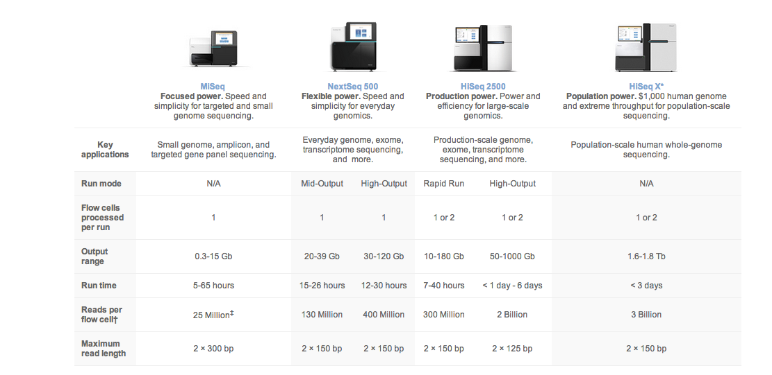
Also dependent on specific instrument used

Slide 10
General basis of all types of NGS analysis
1. Read processing
sample 1
sample 2
sample 3
2. Mapping to template
Template feature
Template feature
Template feature
Discovery
DNA variants
splicing variants
3. Results
region/sample | s1 | s2 | s3
region1 | 6 | 10 | 20
region2 | 150 | 100 | 255
……
Quantitative comparison
Expression
Binding
Methylation

Slide 11
Study design

Slide 12
Sequencing study design
What is the main question for your study?
Characterization / discovery?
(new or different sequence)
Quantification / comparison?
(differential expression – RNA, miRNA, occupancy of binding sites)
How many samples will you sequence?
How much data/samples do you need to answer your question?
What would be the most effective study design?

Slide 13
Coverage

Slide 14

Sequencing study design
Number of samples
Number of reads
$

Slide 15
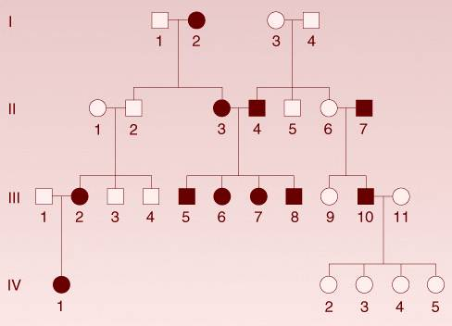
Discovery
Do reads in a certain region differ from template?
Is the difference specific to samples of interest?
Example: a family tree of inherited trait
Template feature
Do you need to sequence many samples?

Slide 16
Discovery
A common strategy is:
Sequence few samples, known to harbor a variant, with high coverage
Careful selection of samples
Make sure you have enough to have power to detect a variant
You want to be certain the sample harbors the variant
Validate the identified variants specifically in other samples
Number of samples
Number of reads

Slide 17
Discovery
A common strategy is:
Sequence few samples, known to harbor a variant, with high coverage
Careful selection of samples
Make sure you have enough to have power to detect a variant
You want to be certain the sample harbors the variant
Validate the identified variants specifically in other samples
Number of samples
Number of reads

Slide 18
Quantification
Is the number of reads mapping to a certain feature (e.g. gene, binding site…) different between samples?
 | Condition A |  |  | Condition B
 | s1 | s2 | s3 | s4 | s5 | s6
region1 | 6 | 10 | 20 | 100 | 60 | 70
region2 | 150 | 100 | 255 | 5 | 3 | 12
……
Number of reads
Number of samples

Slide 19
Coverage
In the simplest form:
N mapped bases in a sample
number of bases in the template
Coverage (X) =
This is the average number of times you will sequence a base of template in the sample, assuming all bases have the same abundance in your sample. This type of calculation is mostly used for variation discovery or new genome assembly studies (genomic DNA, exome sequencing, PCR products etc….), where each base from a template has equal probability to be sequenced.

Slide 20
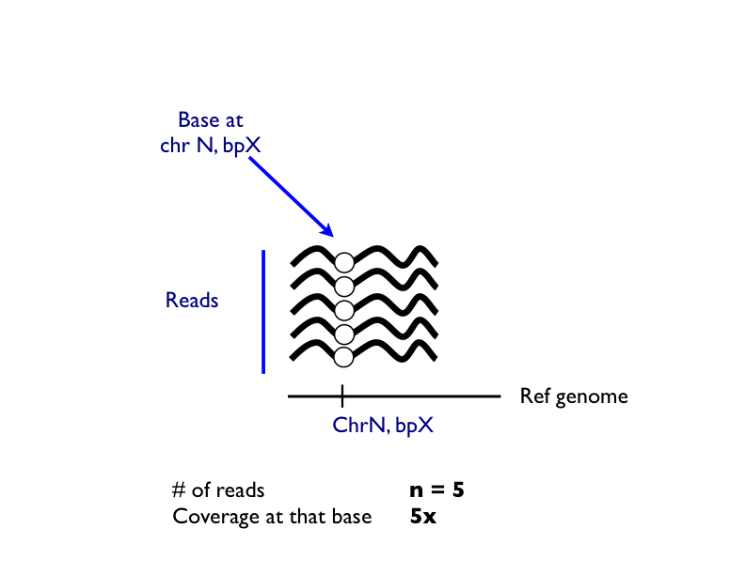
Coverage

Slide 21
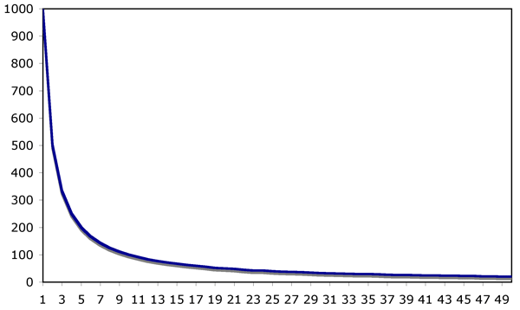
Coverage - how much do you actually need?
Quantification experiments – RNAseq, miRNAseq, Chip-seq
Different parts of the template have different abundances (highly expressed genes versus low, bound versus unbound regions…etc).
Many molecules are rare
Few molecules are very abundant
Number f molecules
Abundance

Slide 22
Coverage - how much do you actually need?
Quantification experiments – RNAseq, miRNAseq, Chip-seq
Different parts of the template have different abundances (highly expressed genes versus low, bound versus unbound regions…etc).
Many molecules are rare
Few molecules are very abundant
Number f molecules
Number of reads
Abundance

Slide 23
Coverage - how much do you actually need?
Quantification experiments – RNAseq, miRNAseq, Chip-seq
Different parts of the template have different abundances (highly expressed genes versus low, bound versus unbound regions…etc).
Many molecules are rare
Few molecules are very abundant
most molecules
produce few reads
most reads are attributed to abundant molecules
Number f molecules
Number of reads
Abundance

Slide 24
Coverage - how much do you actually need?
For quantification experiments, you need to decide how deep you want to sequence:
accurately quantify only highly expressed genes, or
look at the low expressed ones as well?
million reads
Bottom line: if you want high coverage in all/most features, you have to sequence many lanes

Slide 25
Replicates

Slide 26
Replicates – why?
Our data is always based on sampling – we look at N individuals and try to infer about the population. We use statistics to tell us how likely we are to be wrong.
Without replicates, what do you miss?
Variation within the groups (biological noise)
Accuracy of measurement (technical noise)
Sample size

Slide 27
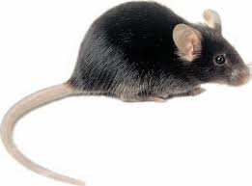
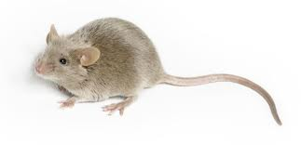
Replicates
Technical replicate = sequence the same sample twice
Biological replicate = sequence several individuals that represent the same biological condition
Sequencing is a measurement technique, with high technical reproducibility (R² are typically >0.97)
technical replicates are usually not required
S1
S2
S3
S4
S5
S6
Technical replicates are: S1 /S2 and S5 / S6
Biological replicates are: S1/S3 and S5/S4

Slide 28
Replicates
Technical replicate = sequence the same sample twice
Biological replicate = sequence several individuals that represent the same biological condition
HOWEVER to make inferences about the population you still need biological replicates
S1
S2
S3
S4
S5
S6
Technical replicates are: S1 /S2 and S5 / S6
Biological replicates are: S1/S3 and S5/S4

Slide 29
Libraries

Slide 30
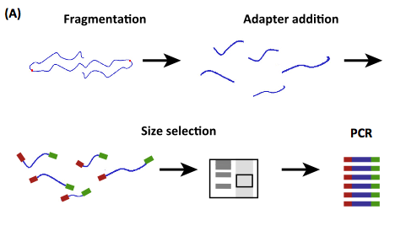
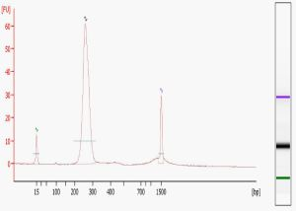
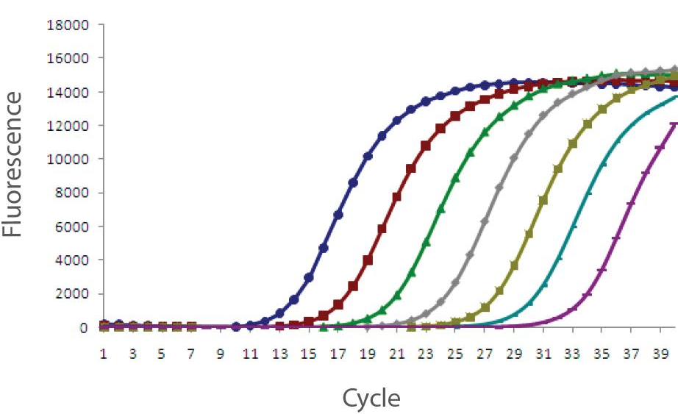
Sample preparation: quality and quantity
QC and quantification
Depends on sequencing facility preference.
Sequencing library

Slide 31
Sample preparation: types of libraries
Single sample per lane or multiplexed?
Multiplexed libraries distribute the samples across lanes. This allows you to use sequencing more efficiently and minimize technical artifacts associated with lane-specificity.
Stranded or unstranded?
Stranded libraries provide information on the strand that the original molecule came from, therefore allowing you to disentangle transcription of overlapping genes, and more accurate sample QC.
PolyA or RiboDepletion?
Ribosomal RNA constitutes >70% of the purified total cell RNA. RiboDepletion removes specifically ribosomal RNA, leaving all other RNA transcripts, however it is not 100% efficient. PolyA selection is very efficient, but it will only select polyadenylated RNA, therefore many long, non coding RNAs will be lost.

Slide 32
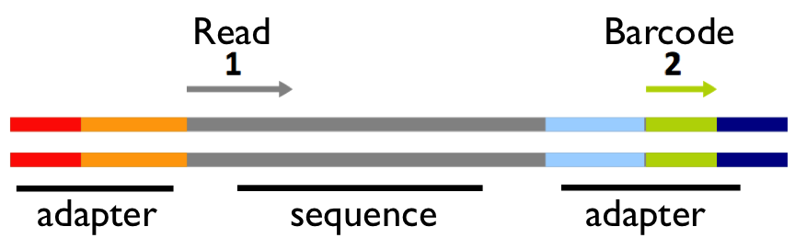
Stranded and Unstranded libraries
Read from + strand
Stranded
Library
Read from - strand
Read from + strand
Unstranded
Library
Read from - strand

Slide 33
Paired-end (PE) and Single-end (SE) libraries
More bases is not always more information.
Types of runs:
PE = paired end
(mate pairs)
SE = single end

Slide 34
PE = paired end (mate pairs)
Is 2*50,000,000 = 100,000,000?
More information on discovery:
New splice variants
New structural variation
More per base coverage
Typically better mapping
(by ~5%)
Less information on quantification:
The 2nd fragment is redundant information for coverage purposes.

Slide 35
Multiplexing

Slide 36
Multiplexing
Sample
Sequencing library
Multiplexing is achieved
by using sample specific adaptors in library preparation step, then sequencing them all together in one lane

Slide 37
Multiplexing
F – number of reads per lane (or unit )
(e.g. 200 x 10⁶ reads / lane)
C – number of raw reads you need per sample
(application dependent)
N – number of multiplex samples
Nmax = F/C
Rule of thumb:
If Nmax is in the order of dozens (miRNAseq) – do 10% less
If Nmax is a single digit number do 1 or 2 less or do accurate quantification of your sample before pooling the library

Slide 38
Lets go through an example
You are interested in comparing gene expression in a knockout mouse of geneX versus wild type

Slide 39
Samples
Number of samples:
How many conditions?
(tissues/time points/sexes/genotypes)
Biological replicates?
Technical replicates?
2
3 per condition
2
Total N = 7 samples
S3
S6
S1
S2
S5
S7
S4

Slide 40
Research question
What information do I want to get?
Differential expression/ quantitation (SE)
Alternative splicing (PE)
Structural variants (PE)
Coverage (low abundance transcripts and allele specific expression require higher coverage)
Multiplexing
Hiseq2000 | Cost $ lane | N reads | $/Mb
SEx50bp | 949 | 325 M | 0.34
PEx50bp | 1496 | 2x 325M | 0.43
SEx100bp | 1233 | 325M | 0.26
PEx100bp | 2063 | 2x 325 M | 0.31
If I do 7 samples per lane I will get ~46.4 million raw reads per sample….
If I need 2 lanes:
2000$- 4000$

Slide 41
Potential bias - pooling the samples:
Library1/Lane1
Library2/Lane2
Design 1
S1
S2
S3
S4
S5
S6
S7
Don’t do this
Design 2
S1
S3
S5
S6
S2
S4
S7
S1
S2
S3
S4
S1
S2
S3
S4
Design 3
S5
S6
S7
S5
S6
S7
technical replicates
WT
KO

Slide 42
Library1/Lane1
Library2/Lane2
Design 2
S1
S3
S5
S6
S2
S4
S7
S1
S2
S3
S4
S1
S2
S3
S4
Design 3
S5
S6
S7
S5
S6
S7
In design 3 you can sequence library 1 and then sequence it again to add coverage (if needed). You will still get preliminary information about differences in all conditions.
In design 2 you will have to sequence both lanes to obtain any meaningful info about differences between conditions.
technical replicates
WT
KO

Slide 43
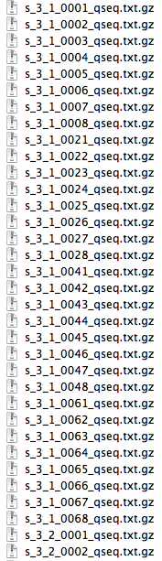
What do you get?
~5-15 GB of .gz text files
These are your reads
...
qseq.txt example:

Slide 44
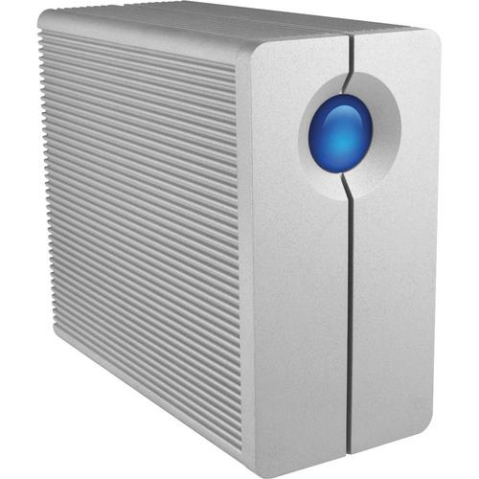
Computational requirements
Data storage:
One lane of 2x50 PE run on HiSeq2000 generates ~15Gb of compressed (.gz) files.
During the analysis:
reads are uncompressed
additional files are generated – filtered and processed reads, mapping files…
Collectively all these may take up to 4 times as much as the original data.
Once the analysis is finished:
original reads
scripts or exact parameters of analysis
alignment file
Bottom line – get a dedicated space/disk for this.
It will fill up quickly

Slide 45
Data analysis requirements:
In house – highly dependent on:
application
number of reads
size of the reference genome / template
Examples: miRNA seq mapping against precursor sequences – any desktop computer will do
For TopHat-Cufflinks RNAseq analysis of mammalian transcriptome I would recommend at least 8Gb RAM (preferably 16 or more)
Enough disk space in memory for all the files (ex: ~4 times the sequencing data)

Slide 46
Day1
NGS study design:
Types of studies
Types of library preparations (stranded, size selection, etc…)
Types of sequencing runs - paired versus single end, read lengths and qualities
Biological replicates
Costs, coverage and multiplexing
Potential biases and batch effects
Computation requirements
NGS analysis – introduction and read QC:
Public resources
Crash Unix course (refresher)
Download your data (refresher)
Read file formats – what do all these columns mean?
Log-in to Hoffman2 cluster
Conversion of “.qseq” read files to “fastq”
Demultiplexing
Read QC
Notes:
Today we are going to discuss study design in depth and start sequence analysis.
The first lecture will focus on the different considerations that affect study design. This is the most important part of your plan, and usually mistakes here are very difficult or impossible to fix in the after math.

Slide 47
General basis of all types of NGS analysis
1. Read processing (de-multiplex, trim, filter…)
sample 1
sample 2
sample 3
De-multiplex
Format conversion
to fasta/fastq
Read QC
Trimming
Filtering
Demultiplex3.pl
qseq2fastq.pl
FastQC
Sickle
Scythe
WS4
WS4
WS2 and WS4
WS2
WS2

Slide 48
Public resources for information
1. Company websites:
Good for planning the study, and tech support if preparing your libraries
http://www.illumina.com
http://www.appliedbiosystems.com
http://www.454.com/
2. Web – establish a workflow before getting the data:
Tool comparison reviews and SEQanswers wiki (http://seqanswers.com/wiki/SEQanswers) - choose few that are common and fit your main question
Protocol articles and manuals – learn how to use the specific tools
Similar studies – GEO datasets, try it out in a safe test run!
3. SEQanswers forum:
Specific questions – I am trying to run program X, data Y and it gives me error Z – HELP!!!
http://seqanswers.com/

Slide 49
Unix refresher

Slide 50
Basic Unix commands
Where am I?
Change directory
Move up one level
Look at a file
Copy a file
Delete a file
Delete a directory
Secure copy
Compress a file
Uncompress file
Uncompress a file
Make a new folder
Current directory
Home directory
List all files in folder
Count lines in a file
pwd
cd cd ~/data
cd ..
less -S fileName
cp /data/file /otherDir/file
rm file
rmdir ~/dirName/
scp user1@host1:file user@host2:file
gzip -c file > file.gz
gzip -d -c file.gz > file
gunzip file.gz
mkdir folderName
./
~/
ls *
wc fileX
Notes:
If you are ever in doubt about how to use a function:
Google!
Unix manual: man functionX
- Note for gzip: the ‘-c’ option is to write to output. If you leave it out, it will simply compress the file in place, replacing the previously uncompressed file (and vice versa for uncompressing files)

Slide 51
Most common sources of errors

Slide 52
Most common sources of errors
Typo in your command. Spaces, capitalization, dots, etc. IT ALL MATTERS. Solution: check and double check your command, then try again.
2. Wrong folder/directory. i.e. you are calling a file or function that does not exist, or is not in the folder you think it is.
Solution: Use commands like ls and cd and find where your file is. Then edit your command with the correct directories and/or file names.
3. Incorrect usage. You are trying to execute a command/function, but the function is expecting you to type something different. It may be the order of the input/output files, the parameters of the function, etc.
Solution: Read the manual. There is always a manual, they have examples. If the manual is too cryptic, google it, somebody, somewhere has most likely put it out there.

Slide 53
Most common sources of errors
4. Out of hard disk memory. i.e. you don’t have enough space to continue writing output files, etc.
Solution: Check your folder space, how much you are using and have left. Move, delete, or compress files to free up space.
5. Out of RAM memory. i.e. you don’t have enough RAM to execute a given command or set of commands.
Solution: If you are in the cluster, simply request more! For example using qrsh, we’ll show you how.

Slide 54
Download / Upload your data to Hoffman
You have a few options:
Use rsync to download your data on Hoffman directly from your sequencing facility/server
Use scp, secure copy, to copy files from your computer to Hoffman
GUI program such as Cyberduck
- In general these work ok, but crash for very large files

Slide 55
Download your data with rsync
Make a directory
mkdir data
Go the directory you just created
cd data/
If you get data from the stem cell sequencing core, you will get ‘credentials’ that look like this:
mySample SxaQSEQsXA032L7:pasword123

Slide 56
Download your data with rsync
Download using rsync
rsync [OPTION]... rsync://[USER@]HOST[:PORT]/SRC [DEST]
This downloads all the gzipped sequencing files from the server to a current directory. It will ask you for the password
rsync rsync://SxaQSEQsXA032L7@pan.pellegrini.mcdb.ucla.edu:/SxaQSEQsXA032L7/*gz ./
Get all “.gz” files in directory. Name of directory is the same as user name given
USER@HOST
Put files in current directory

Slide 57
Upload data to cluster using scp
Usage:
scp user@host1:file user@host2:file
Sample commands:
cd ~/Desktop/Workshop4/
scp file1 userID@hoffman2.idre.ucla.edu:~/file1
Copy from here, my file in the current directory
To Hoffman
Place in this directory in Hoffman
Notes:
Another example, to copy all gz files in the current direcotry:
scp ./*gz ldorozco@hoffman2.idre.ucla.edu:~/data/

Slide 58
Sequencing file formats

Slide 59
Read analysis - what do you get?
N files of reads
File name contains information!
...
s_3_1_0065_qseq.txt.gz
tile number
lane
read direction/read type
* In paired end sequencing reads 1 and 2 from the same tile should have the same number and order of reads.
* In multiplexed sequencing reads 1 and 2 from the same tile should have the same number and order of reads. Read1 file has the reads, read2 file has the barcodes

Slide 60
qseq format
SN608 VAP003 2 2208 33.30 98.40 0 2
SN608 VAP003 2 2208 38.40 99.10 0 2
SN608 VAP003 2 2208 63.30 98.20 0 2
SN608 VAP003 2 2208 60.10 98.60 0 2
SN608 VAP003 2 2208 66.80 98.80 0 2
1 2 3 4 5 6 7 8
CTGGGATTTATTTATTCGGTTTGCAAGCTGTAAGTCTCCCCCACTGCTTC aaacacYabK[`bdefK[RRa_e^JQQ`dI_ged^Ibfg]U_HWWXaSI^ 0
CAGGGACACTGACGTAGATCAGCAAGGAGTATTCGACTTTGAGGATGTTG _Z^ccPca`ceYce`aefhgfb_`bdf^b^^cb]f^Ucececef[eaaWa 1
CCTAGGCAGCACTAGGCAGGCTGGGGGGCCACAAAGCGAAGAAGGCATGG Z^^ccc`^c^R`e_`d]]eaUaefbH^YEUGQJ[[bREQUUHW][GGJWW 1
AGGAGATGGCCTTTTTGGGCAAGGACAAGCCATCTTCAGAGAATAATGAG ^__`c\`cecgggifhfiihidafecgadfhhfhif`ccafXaca^a_ef 1
GCCATCAATGTCACCAATCAGTGCCTTTGAGGGTTGTCCATCTCCCAAAG _V^^cdcac``c^bfgiJ`Y^b`gacghfX`ZbbeggfI^[aeYa_Xaf[ 0
9
10
11
Machine name: unique identifier of the sequencer.
Run number: unique number to identify the run on the sequencer.
Lane number: positive integer (currently 1-8).
Tile number: positive integer.
X: x coordinate of the spot. Integer (can be negative).
Y: y coordinate of the spot. Integer (can be negative).
Index: positive integer. No indexing should have a value of 1.
Read Number: 1 for single reads; 1 or 2 for paired ends.
Sequence
Quality: the calibrated quality string.
Filter: Did the read pass Illumina filtering? 0 - No, 1 - Yes

Slide 61
fastq format
unique identifier/name, equivalent to columns 1-8+11 in qseq.txt format
Read sequence
@ERR030881.107 HWI-BRUNOP16X_0001:2:1:13663:1096#0/1
ATCTTTTGTGGCTACAGTAAGTTCAATCTGAAGTCAAAACCAACCAATTT
+
5.544,444344555CC?CAEF@EEFFFFFFFFFFFFFFFFFEFFFEFFF
@ERR030881.311 HWI-BRUNOP16X_0001:2:1:18330:1130#0/1
TCCATACATAGGCCTCGGGGTGGGGGAGTCAGAAGCCCCCAGACCCTGTG
+
GFFFGFFBFCHHHHHHHHHHIHEEE@@@=GHGHHHHHHHHHHHHHHHHHH
@ERR030881.1487 HWI-BRUNOP16X_0001:2:1:4144:1420#0/1
GTATAACGCTAGACACAGCGGAGCTCGGGATTGGCTAAACTCCCATAGTA
+
55*'+&&5'55('''888:8FFFFFFFFFF4/1;/4./++FFFFF=5:E#
a constant meaningless field to ignore
Qseq fastq devotes 4 lines to each read while, qseq just one. Fastq is the format most commonly used by many aligners and QC programs
Quality string

Slide 62
Log-in to Hoffman

Slide 63
Log-in to Hoffman
Log-in to Hoffman. On terminal, type:
ssh userID@hoffman2.idre.ucla.edu
Request an interactive session:
qrsh -now n -pe shared 2 -l i,h_data=4G,h_rt=2:00:00

Slide 64
Request a session on hoffman with qrsh
qrsh -now n -l i,mem=4G,time=2:00:00
keep trying until a session with these specs is available
type of session:
i = interactive
highp = high priority

Slide 65
Request a session on hoffman with qrsh
qrsh -now n -l i,mem=4G,time=2:00:00
Memory requested, options:
mem=1G, mem=2G, mem=4G
or for over 4G, e.g. for total of 8G:
-pe shared 2, mem=4G

Slide 66
Request a session on hoffman with qrsh
qrsh -now n -l highp,mem=4G,time=2:00:00
or
qrsh -now n -pe shared 2 -l i,mem=4G,time=2:00:00
For interactive sessions (i), you use the ‘shared’ cores. The time limit is 24 hrs. The shared cores are busy, so the less time and memory you request, the faster you will get a session, mem=2G and time=2:00:00 is the default. But, there are potentially thousands of cores available to you.
For high priority sessions (highp), you use your group’s cores. Time limit is 1 week (168hrs) and depending on how busy your group is, you may get a session fast, but the number of cores available to you will be less.
More info: http://hpc.ucla.edu/hoffman2/computing/sge_qrsh.php

Slide 67
WARNING: Spaces matter in Unix!
This works:
qrsh -now n -l i,mem=4G,time=2:00:00
This does not:
qrsh -now n -l i, mem=4G,time=2:00:00

Slide 68
Working on Hoffman: Scratch folder space
Use your “scratch” folder. To check if you have one:
ls /u/scratch/j/jbruin/
Example, my (Luz) scratch space is:
/u/scratch/l/ldorozco/
If you do not have a scratch folder, create it:
mkdir /u/scratch/j/jbruin/
Let’s make a shortcut for it:
ln -s /u/scratch/j/jbruin/ ~/scratch

Slide 69
Mapping on Hoffman: Sample data
Copy sample data folder to your scratch folder:
cp -R /u/scratch/l/ldorozco/Workshop4 ~/scratch/
Same as:
cp -R /u/scratch/l/ldorozco/Workshop4 /u/scratch/j/jbruin/
To view it:
ls ~/scratch/Workshop4/

Slide 70
Demultiplexing examples on Hoffman2 cluster

Slide 71
Multiplexing
Sample
Sequencing library
Multiplexing is achieved
by using sample specific adaptors in library preparation step, then sequencing them all together in one lane

Slide 72
Demultiplexing
Multiplexing is using sample specific adaptors in library preparation step, then sequencing them all together in one lane
S1
S2
S3
S1
S2
S3

Slide 73
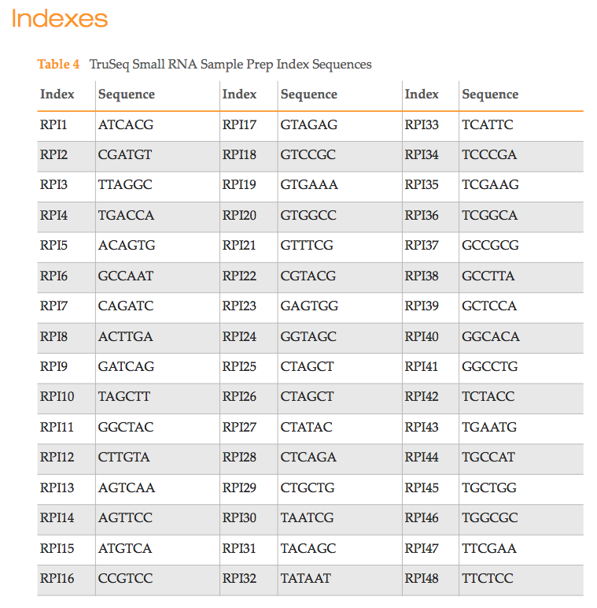
Barcodes
Ideally barcodes should differ by at least 3 changes

Slide 74
Demultiplexing reads in different formats
Option A – Qseq files - separate files (qseq.txt)
Read file is the first end: s_7_1_1101_qseq.txt
SN603 WA043 7 1101 37.30 108.30 0 1 TAGCACCATCTGA…. bbeeeeege… 0
SN603 WA043 7 1101 49.50 113.10 0 1 TGTCTGAGCGTCG…. bb_eeeeeg… 1
Barcode file is the second end: s_7_2_1101_qseq.txt
SN603 WA043 7 1101 37.30 108.30 0 2 GTGAAAA geggcgg 0
SN603 WA043 7 1101 49.50 113.10 0 2 ACAGTGA ghihiihii 1
Option B – FASTQ files - barcode is part of the read (.fastq)
TAGCACCATCTGA….GTGAAAA
TGTCTGAGCGTCG….ACAGTGA

Slide 75
Demultiplexing steps – Option A
sample 1.fastq
sample 2.fastq
1. Demultiplex3.pl
2. qseq2fastqYH.pl
1. Demultiplex qseq file
2. Convert qseq to fastq (Optional. Only necessary if you are using other scripts that require fastq format)

Slide 76
1.Demultiplex qseq file
Inputs:
1) Script name: Demultiplex3.pl
2) In your directory, you must have the end1 qseq files (file with reads)
3) In your directory, you must have the end2 qseq files (file with barcodes)
4) In your directory, barcode file with list of barcodes used in your experiment, named “barcodes.txt”
Outputs:
One qseq file for each barcode used. Script will demultiplex all qseq files in your directory
Run command:
cd ~/scratch/Workshop4/DemultiplexA/
perl Demultiplex3.pl

Slide 77
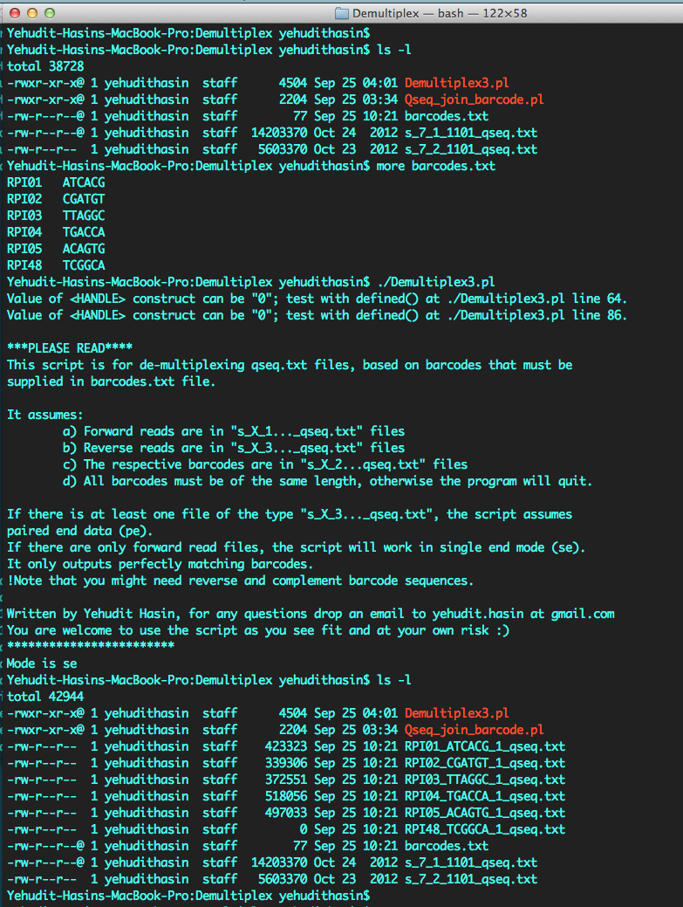
1. Running Demultiplex3.pl
Input
Running
Generic script message
about how it works
Message about single or paired end mode (se/pe)
Output

Slide 78
2. Convert qseq file to FASTQ file
Inputs:
1) Script name: qseq2fastqYH.pl
2) Script will prompt you with 2 questions, inputs are yes or no (y/n):
Question 1) Remove Illumina filter=0 reads (y/n)?
Question 2 ) Convert quality scores to Sanger from encoding Illumina Ill1.8 or higher (y/n/g)?
For Question 2) option g, for “guess”, can be used if you do not know the encoding of your file, it will try to guess.
Outputs:
Script will convert all qseq files in the current directory to FASTQ files
Run command:
cd ~/scratch/Workshop4/DemultiplexA/
perl qseq2fastqYH.pl

Slide 79
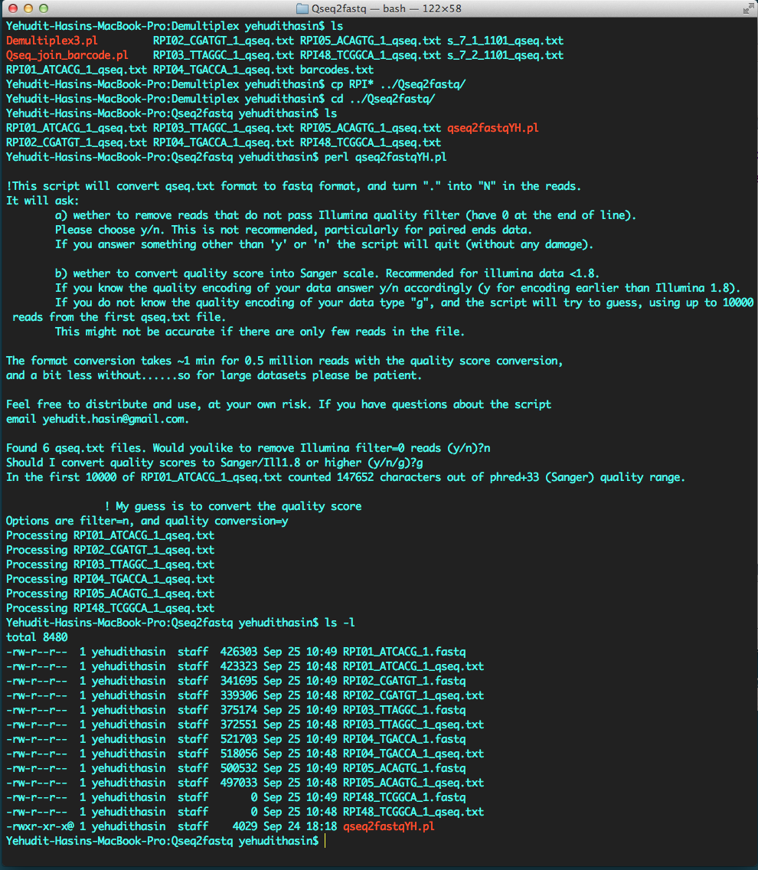
2. Running qseq2fastqYH.pl:
User input1 – filter Illumina quality=0? (y/n)
User input2 – convert quality scores? (y/n/g)
If user input2 = “g”,
message what was the guess and why
Tracking progress
Output

Slide 80
Demultiplex - Option B
TAGCACCATCTGA….GTGAAAA
TGTCTGAGCGTCG….ACAGTGA
sample 1.fastq
sample 2.fastq
1. De-multiplex
Fastx barcode splitter
Demultiplex FASTQ reads using barcode splitter
In FASTQ format, the barcode is often part of the read, and may be in the beginning of the read (5’) or end of the read (3’)

Slide 81
1. Demultiplex FASTQ file
Inputs:
1) Sequence file with merged sequence and barcode in FASTQ format
2) Script name: fastx_barcode_splitter.pl
3) Name of barcode file: --bcfile barcodes.txt
4) Specify if barcodes are in beginning or end of the sequence:
beginning of line: --bol
end of line: --eol
5) Number of mismatches allowed, ex: 1
6) A prefix or output directory, ex: --prefix ./out_
Outputs:
Output is one split file for each barcode used, plus one file with reads not matched to any barcode. Names of files start with your prefix and barcode index
Notes:
To download toolkit: https://github.com/agordon/fastx_toolkit
Tools: FASTX (http://hannonlab.cshl.edu/fastx_toolkit/commandline.html)

Slide 82
1. Demultiplex FASTQ file
Run command:
cd ~/scratch/Workshop4/DemultiplexB/
cat bar_s_7_1_1101.fastq | perl fastx_barcode_splitter.pl --bcfile barcodes.txt --bol --mismatches 1 --prefix ./out_
Notes:
To download toolkit: https://github.com/agordon/fastx_toolkit
Tools: FASTX (http://hannonlab.cshl.edu/fastx_toolkit/commandline.html)

Slide 83
Quality scores

Slide 84
Quality scores
aaacacYabK[`bdefK[RRa_e^JQQ`dI_ged^Ibfg]U_HWWXaSI^
These are coded quality scores. When you do QC, these get converted to a number (Phred score), that represents the probably of a base-calling error
Notes:
Phred quality scores are used for:
Assessment of sequence quality
Recognition and removal of low-quality sequence (end clipping)
Determination of accurate consensus sequences

Slide 85
qseq.txt format:
Quality scores – Illumina filter
CTGGGATTTATTTATTCGGTTTGCAAGCTGT…CCACTGCTTC aaacacYabK[`bdefK[RRa_e^JQQ`dI_ged^Ibfg]U_HWWXaSI^ 0
CAGGGACACTGACGTAGATCAGCAAG…TTTGAGGATGTTG _Z^ccPca`ceYce`aefhgfb_`bdf^b^^cb]f^Ucececef[eaaWa 1
CCTAGGCAGCACTAGGCA…CACAAAGCGAAGAAGGCATGG Z^^ccc`^c^R`e_`d]]eaUaefbH^YEUGQJ[[bREQUUHW][GGJWW 1
9
10
11
Quality filter (field 11) is encoded by 0/1 and is determined independently of quality string. It is an Illumina filter that indicates whether the cluster is likely to be pure (1) or contaminated from another cluster (0).
Although it is independent, the 0 reads are typically of lower overall quality than 1 reads.
Most people consider it too stringent and ignore it

Slide 86
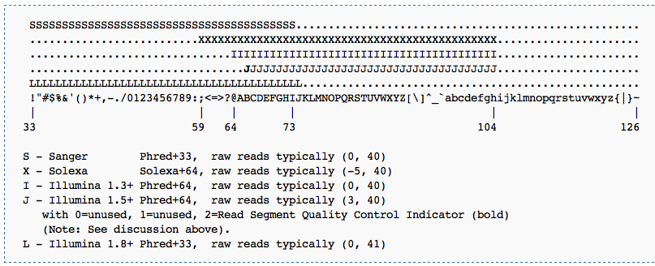
qseq.txt format: Quality scores
To add to this, some of the Illumina versions (all up to 1.8) encode the quality in a different range of ASCII code than the accepted Sanger……
Thus, if you want to convert the qseq files to fastq you need first to find out which encoding was used, and then to convert it to Sanger…..
http://en.wikipedia.org/wiki/FASTQ_format#Quality
Notes:
When people talk about Phred scales, they mean the range of ASCII numbers used to define the quality scores. The original Phred scale ranged from 33 to 126.
Why did they choose to start with 33? It is because ASCII characters before 33 were mostly non-displayed characters like 32 which is a blank space or 10 which is a line-break.
The original Phred scaling of 33-126 is also called the Sanger scale.
There are also 2 other scales used by Illumina that shifts the range up:
Solexa/Illumina 1.0 format uses ASCII 59 - 126 representing scores -5 - 62
Illumina 1.3+ format uses ASCII 64 - 126 representing scores 0 - 62.
To convert between these scores, one will have to be able to get the ASCII number representation of the character and subtract from it to account for the scale shifts.

Slide 87
Read processing
Many mapping and analysis programs work with fastq format and Sanger quality
In that case you need to convert qseq.txt to fastq, and make sure the quality is sanger.

Slide 88
Quality control using FastQC

Slide 89
Read quality reports using “FastQC”
Downloaded from
http://www.bioinformatics.babraham.ac.uk/projects/fastqc/
Manual:
http://www.bioinformatics.babraham.ac.uk/projects/fastqc/INSTALL.txt
Inputs:
Script name: fastqc
Output directory. Ex: current directory ./
FASTQ file to process

Slide 90
FastQC on Hoffman cluster
Go to QC directory
cd ~/scratch/Workshop4/QC/
Run FastQC from this directory. This runs all fastq files in directory:
cd ~/scratch/Workshop4/QC/
./FastQC/fastqc -o ./ *fastq

Slide 91
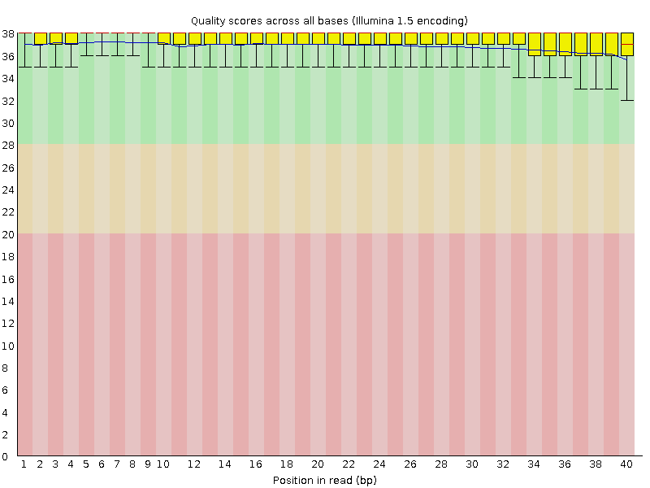
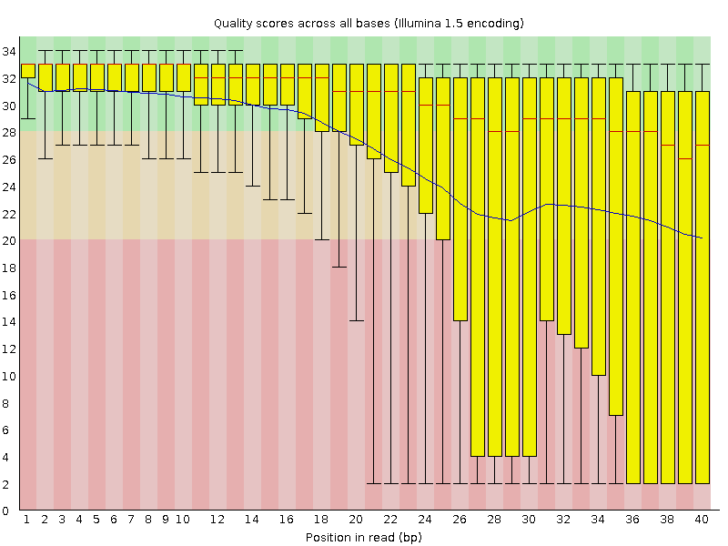
FastQC – quality distribution
Perfect
Bad
Trimming needed

Slide 92
Trimming (aka clipping or hard clipping)
100 bp
read
cut last 5 bases
95 bp
trimmed
read

Slide 93
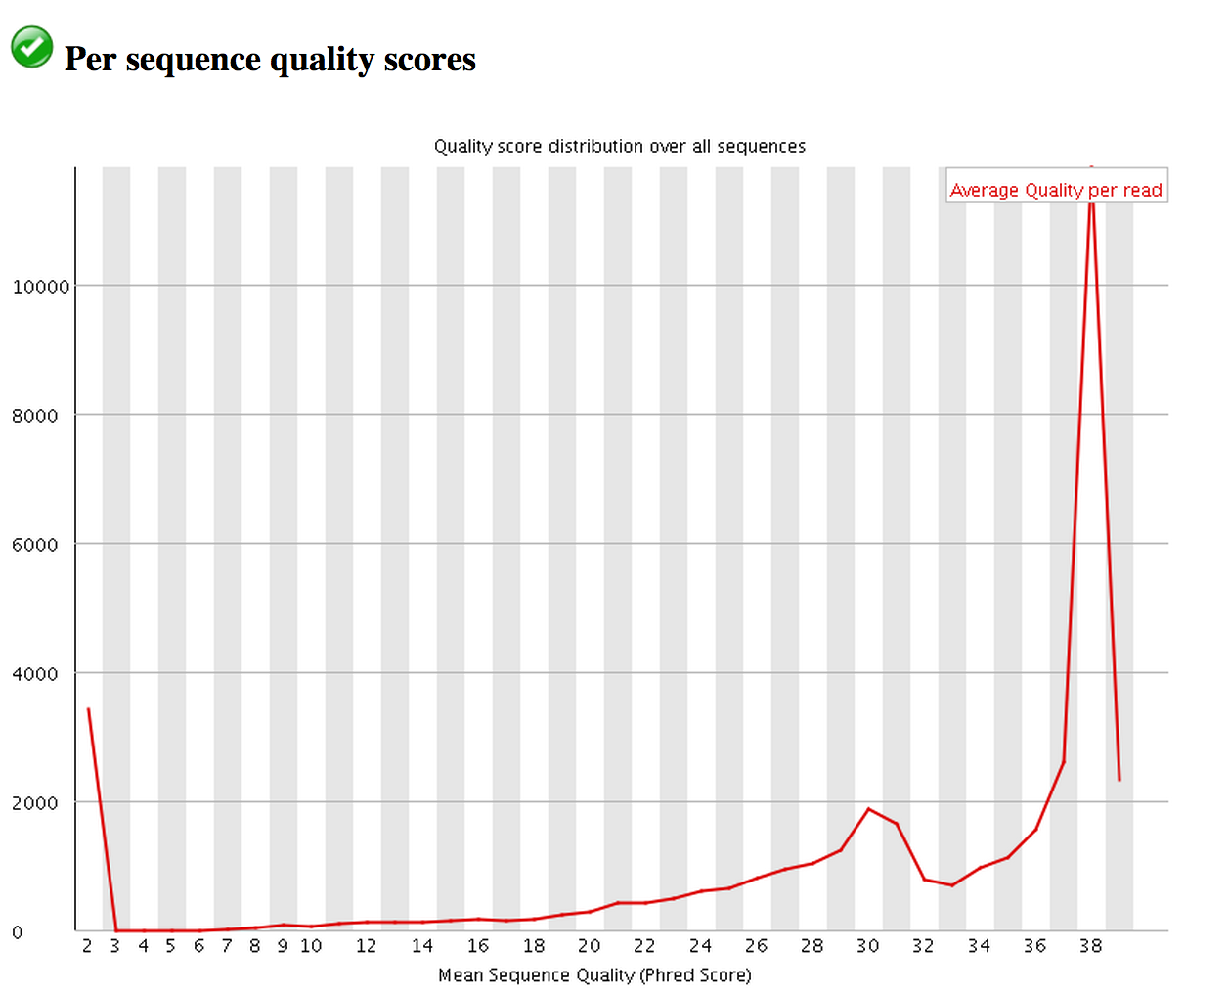
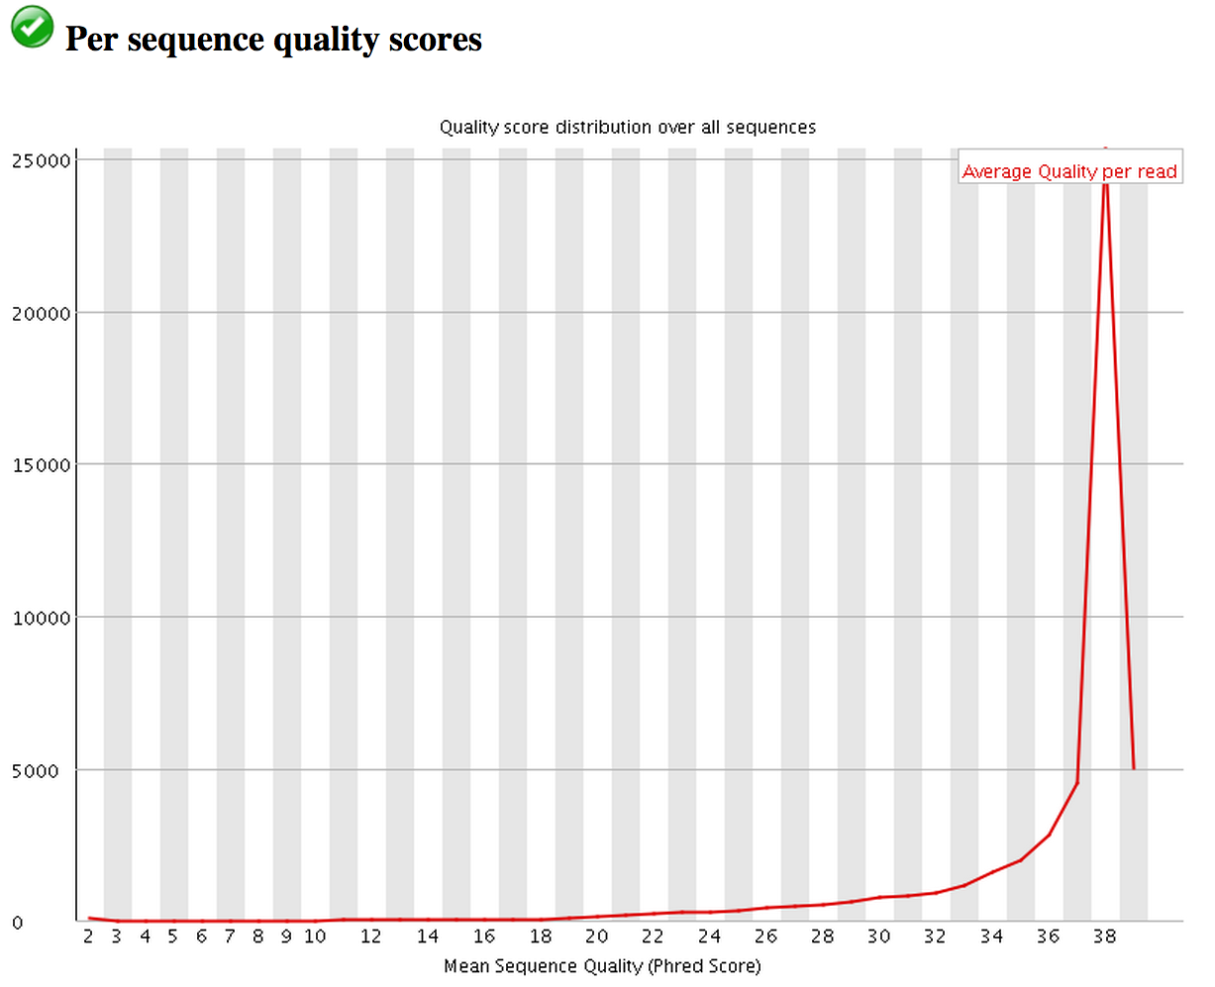
Read processing
Quality score distribution
over all reads
Bad
Filtering
needed
Filter?
Mean Sequence Quality (Phred Score)
Good

Slide 94
Filtering
Throw out reads with bad average quality scores

Slide 95
Read trimming and filtering
The quality distribution plot and nucleotide composition may indicate potential problems.
Quality of reads decays throughout the read. It is common practice to trim the low quality bases – either by hard clipping or by quality sliding window – thus shortening the read to a higher quality region
Low quality is typically considered Q<20-25.
Metrics that report sequence content, may be skewed by the application (e.g. miRNA-seq) rather than present a true problem

Slide 96
Read processing – does it help mapping?
 | N reads | N mapped | % mapped
Fastq | 10785552 | 8466534 | 78%
Trimmed | 10785552 | 8572533 | 79%
Filtered | 8153011 (75% of total) | 7302082 | 89%
Filtering will increase % of mapped reads (usually significantly), but it will reduce the total number of mapped reads, and thus the coverage.
Trimming may or may not increase mapping depending on data quality.

Slide 97
QC recommendations
Generate QC plots for all libraries
Trim and/or filter if needed
Regenerate quality plots after trimming/filtering to determine effectiveness

Slide 98
End Part1
Questions?

